Slide 1
Module 5
Mgmt 6062 - Project Risk and Quality

Slide 2
Module agenda
Objectives of quantitative risk analysis
Expected Monetary Value (EMV)
Quantitative risk analysis of Kilimanjaro Expedition
Tools: Monte Carlo simulation; decision trees, failure modes and effects analysis
Steps for the Perform Quantitative Risk Analysis process
Project risk scoring – an alternative approach
Homework/evaluations

Slide 3
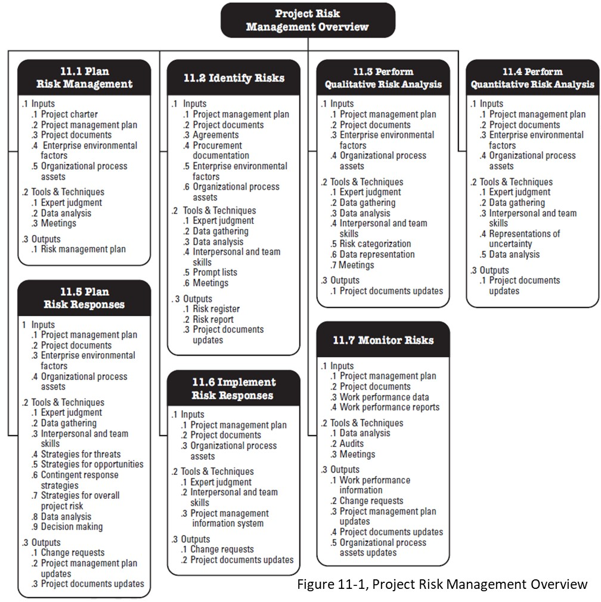
Module agenda
Qualitative
Risk Analysis

Slide 4
Perform quantitative risk analysis
Numerically analyze the probability and impact of each risk and entire project.
Determine how much risk the project has, and where, so that you can focus on areas of greatest risk to lower the risk on the project.
Helps make more informed decisions about risk on project.
The more complex the project, the more time should be spent on Quantitative Risk Analysis, but it is not always needed for all projects.

Slide 5

Objectives of perform quantitative risk analysis
Decide which risks warrant a response.
Objectively, numerically evaluate the probability and impact of each risk.
Determine overall project risk and make a “go/no go” decision on project.
Determine project cost and time if no further risk management activities are done.
Determine probability of completing the project on time and on budget.
Notes:
“Determine project cost and time if no further risk management activities are done.” – the phrase “no further … activities are done” means after analyzing a risk quantitatively, we can use the risks to estimate cost and time.
But perhaps the risks are so high, or the cost too high, or the time so long, that we add additional activities to our project list of activities. For example the time was too long do to multiple risks, so we added additional activities to reduce the project time frame.

Slide 6
Inputs required for quantitative risk analysis
Risk Management Plan
Risk register so far. Risks ranked and risks carried forward for further analysis are identified.
Historical records: how were similar risks quantified in the past.
Cost management plan and time management plan (and other plans)

Slide 7
Probability and impact
Ways to quantify probabilities and impacts:
Calculate the expected cost and/or time impact.
Use historical records.
Conduct interviews.
Use the Delphi technique (also next slide) https://project-management-knowledge.com/definitions/d/delphi-technique/
Worst case, if you do not have the objective data: “guesstimate” at a percentage of probability, or a cost or time impact using subjective judgement.
Notes:
It is okay to guess probability and impact if objective data is not available. It should be based on a calculated estimate like two weeks, $34,000 or 20% probable. It would be better to be objective but it is not always possible. To decrease limitations of subjective evaluations estimate something small like work packages instead of a larger piece of work and give as much detail as possible to the person performing the evaluation.
Interviews: Interviews with different people for each risk can be very time consuming. Can combine with Identify Risks process but you will end up spending time collecting probabilities and impacts for risks that do not make it past the qualitative risk analysis stage.
The Delphi Technique is an approach used to solicit opinions and information from a group of experts anonymously, in order to avoid differences of opinions that could damage egos resulting in lower participation and performance of the group. https://project-management-knowledge.com/definitions/d/delphi-technique/

Slide 8
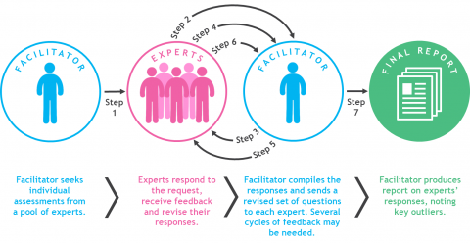
Delphi technique
The Delphi Technique is used to solicit opinions and information from a group of experts anonymously, to avoid differences of opinions that could damage egos resulting in lower participation and performance of the group.
Notes:
Source https://www.liberaldictionary.com/delphi-technique/

Slide 9

Estimated Monetary Value (EMV) My bulldozer Broke down!
You own a construction company
You have only one bulldozer
If it breaks down, you can probably fix it yourself but you need to rent another while your equipment is repaired, it costs $2000 per day to rent a bulldozer.
Based on previous projects and the age of your bulldozer, there is a 10% chance it will break down. Repairs would take two days.
What is the EMV of a potential bulldozer breakdown considering only the rental cost?
There could be other costs or impacts.
An EMV event that costs money or delays a project is considered negative (-). This is the reverse of what we use in our Risk Register.
EMV = 0.10 x -$2000 x 2 days = -$400 or negative $400
What do you do with that EMV as you plan your project?

Slide 10
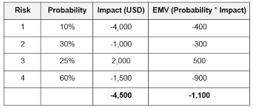
Expected monetary value (EMV) of risks
Expected Monetary Value is the probability-weighted average of all possible outcomes, calculated by summing all the quantitative probabilities times impacts for risk on a project.
Threats are negative and opportunities are positive in EMV. Therefore, risk 3 is actually an opportunity (not a threat).
EMV = ∑ (P x I)
Opportunity

Slide 11
Emv exercise
Handout
You are planning the design of new software. Your project estimate results in a net project cost of CAD $800,000 and schedule of 448 days. In addition, your analysis has come up with the following (keep in mind that the real world will probably have many more risks than the five listed here):
There is a 10 percent probability of a stakeholder making a major change to the project, costing the project $150,000 and a 28 day delay.
There is a 30% probability of gaining a new, valuable resource, making the project $60,000 cheaper and saving 56 days.
There is a 70% probability that the software will be delayed in its release from the vendor, resulting in an extra $6,000 labour expense and a 40-day delay.
There is a 10% probability that the coding may be simpler than expected, resulting in a $5,000 savings and a savings of 14 days.
There is a 10% probability of a major bug causing $16,000 of rework and a 42 day delay.
What is the expected monetary value of the cost and time of these risks?

Slide 12
EMV exercise
Handout
Risk | Calculation | Expected Monetary Value of the Cost
A
B
C
D
E
 |  | Total
Risk | Calculation | Expected Monetary Value of the Time
A
B
C
D
E
 |  | Total

Slide 13
EMV exercise – EMV for risks in a project
Risk | Calculation | Risk Type | EMV of the Cost
A | -0.10 x $150,000 | Threat | -$15,000
B | 0.30 x $60,000 | Opportunity | $18,000
C | -0.70 x $6,000 | Threat | -$4,200
D | 0.10 x $5,000 | Opportunity | $500
E | -0.10 x $16,000 | Threat | -$1,600
 |  |  | Total -$2,300

Slide 14
EMV exercise – EMV for risks in a project
Risk | Calculation | Risk Type | EMV of the Cost
A | -0.10 x $150,000 | Threat | -$15,000
B | 0.30 x $60,000 | Opportunity | $18,000
C | -0.70 x $6,000 | Threat | -$4,200
D | 0.10 x $5,000 | Opportunity | $500
E | -0.10 x $16,000 | Threat | -$1,600
 |  |  | Total -$2,300
Risk | Calculation | Risk Type | EMV of the Time
A | -0.10 x 28d | Threat | -2.8 d
B | 0.30 x 56d | Opportunity | 16.8 d
C | -0.70 x 40d | Threat | -28 d
D | 0.10 x 14d | Opportunity | 1.4 d
E | -0.10 x 42d | Threat | -4.2 d
 |  |  | Total -16.8 days

Slide 15
EMV exercise
Handout
Assuming that these five risks are the only risks on the project:
What is the best case (only good things happen, opportunities)?
With no further analysis (without a risk analysis), how much will management expect the project to cost and it’s duration?
What is the expected monetary value of the project?
What is the worst case (only bad things happen, threats)?
Note, although our risk analysis EMV could be negative because we only have threats (which are going to cost us more money), we would flip the EMV to a positive number when we add it to our estimated project budget. We need a larger budget to deal with the threats, if we add a negative number we would end up reducing our budget.

Slide 16
EMV exercise
Handout
You are planning the design of new software. Your project estimate results in a Work Package estimate of CAD $800,000 and schedule of 448 days. What would be your estimates?
 | Question | Answer for Cost
a | Best case
b | Estimate excluding risks
c | Expected monetary value
d | Worst case
 | Question | Answer for Time
a | Best case
b | Estimate excluding risks
c | Expected monetary value
d | Worst case

Slide 17
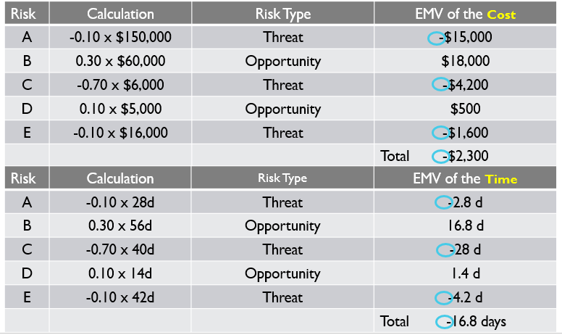
EMV exercise
You are planning the design of new software app. Your project estimate results in a Work Package estimate of CAD $800,000 and schedule of 448 days. What would be your Best Case estimate?
 | Question | Answer for Cost
a | Best case | 800,000-60,000-5,000=$735,000
b | Management expects | $800,000
c | Expected monetary value | 800,000+2,300=$802,300
d | Worst case | 800,000+150,000+6,000+16,000=$972,000
 | Question | Answer for Time
a | Best case | 448-56-14=378d
b | Management expects | 448d
c | Expected monetary value | 448+16.8=464.8d
d | Worst case | 448+28+40+42=558d

Slide 18
EMV exercise
You are planning the design of new software app. Your project estimate results in a Work Package estimate of CAD $800,000 and schedule of 448 days. What would be your estimates?
 | Question | Answer for Cost
a | Best case | 800,000-60,000-5,000=$735,000
b | Estimate excluding risks | $800,000
c | Expected monetary value | 800,000+2,300=$802,300
d | Worst case | 800,000+150,000+6,000+16,000=$972,000
 | Question | Answer for Time
a | Best case | 448-56-14=378d
b | Estimate excluding risks | 448d
c | Expected monetary value | 448+16.8=464.8d
d | Worst case | 448+28+40+42=558d

Slide 19
EMV exercise
You are planning the design of new software app. Your project estimate results in a net project cost of CAD $800,000 and schedule of 448 days.
Interpretation:
Without analyzing risks, a person could say that the project budget should be $800,000 and take 448 days.
Taking the uncertainties into account the project cost could range from $735,000 and 378 days to $972,000 and 558 days.
If no further risk management actions are taken to decrease threats or increase opportunities the project could be re-estimated to cost $802,300 and take 465 days.
If $972,000 and 558 days are beyond the risk tolerances, the Plan Risk Responses process should be done to reduce or eliminate some threats impacting costs and time.
 | Question | Answer for Cost
a | Best case | $735,000
b | Estimate excluding risks | $800,000
c | EMV | $802,3000
d | Worst case | $972,000
 | Question | Answer for Time
a | Best case | 378d
b | Estimate excluding risks | 448d
c | EMV | 464.8d
d | Worst case | 558d

Slide 20
Kilimanjaro expedition quantitative risk analysis
Use the subset of a risk register template provided.
Do Quantitative Risk Analysis for the Kilimanjaro Expedition for risks that were identified to move forward in the Qualitative Risk Analysis stage.
Students to work in pairs or as individuals, and perform quantitative analysis on one risk.
Which risks needs Risk Response Planning?
Use the following slide to gather objective data

Slide 21
Kilimanjaro expedition quantitative risk analysis
http://www.kilimanjaroguides.com/choosing-kilimanjaro-guides-price
Kilimanjaro park fees $100/day
Choose mid priced operator
Peak Planet Rongai 6 day - $2150 August 30, 2014. http://www.peakplanet.com/dates-prices/group-climbs-2014/ $1675 Umbwe Route: Ultimate Kiliminjaro, $1675 ($280/day) http://kilimanjaroexpeditions.com/rates.aspx
Trekking conditions: http://www.peakplanet.com/climb-information/trekking-conditions/
http://www.ultimatekilimanjaro.com/preparation.htm#gearlist
1000 people are evacuated from Kilimanjaro and 10 deaths per year due to altitude sickness out of 35000 http://www.ultimatekilimanjaro.com/acclimatization.htm
Tanzanian Shilling ($1=1,744 TSh 31Jan20)
Airline cancellation data https://www.htrends.com/trends-detail-sid-80661.html
Cost of cancelling expedition more than 60 days before is $500 per person
Notes:
Airlines post higher rate of on time flights, lower rate of cancellations in august

Slide 22
Subset of a risk register
Handout
 | Quantitative Cost ($) |  |  |  | Quantitative Time (days)
Risk Name and Description | Prob P % | Impact I $ | P X I $ | Risk Ranking | Prob P % | Impact I (days) | P X I (days) | Risk Ranking | Potential Responses
IMPORTANT:
In the previous module, we use probability x impact in a QUALitative way (e.g., ratings out of 10), to prioritize the risks.
In QUANTitative analysis, we are using percentage for probability, and dollars/days for impact.

Slide 23
Tools for quantitative analysis
Monte Carlo Simulation
Decision trees
Failure modes and effects analysis

Slide 24
Tool: monte carlo simulation
You need software such as Excel [RAND() function or Excel add ins] or simulation software (@Risk) -- and a range of time estimates and cost estimates (such as optimistic, most likely and pessimistic) for each activity, and lastly a network diagram.
The software uses a random sampling process to pick up one time estimate / cost estimate for each activity (within the range of optimistic and pessimistic) and determine the project length and critical path and project cost.
The software will redo the simulation five hundred or more times in order to run a probability distribution. It uses a random sampling process to select one of the possible estimates for time/cost for each activity from the available probability distribution (within the range of optimistic and pessimistic) .
https://www.youtube.com/watch?v=9LxoP39P5iY (4:53) Monte Carlo simulation of risk in costs of a project. The first 2.5 minutes provide an illustration of variability in a project.

Slide 25

Tool: monte carlo simulation
When can you retire based on your retirement goals and expectations from your investments?
INPUT
OUTPUT
Probability distributions for investments
Assumptions: need $1M at age 65
Analysis/data to help make decisions
Monte Carlo “Magic”

Slide 26
Tool: monte carlo simulation
INPUT
Most likely value
Probability distributions for investments
Probability
Lowest value
Highest value
Value $

Slide 27
Tool: monte carlo simulation
When can you retire based on your retirement goals and expectations from your investments?
INPUT
OUTPUT
Probability distributions for investments
Assumptions: need $1M at age 65
Analysis/data to help make decisions
Monte Carlo “Magic”

Slide 28
Tool: monte carlo simulation
OUTPUT
Interpretation: 20% risk of not achieving retirement savings ($1M) for retirement at age 65.
What to do?
Work to age 72 for 90% confidence in having $1M?
Set lower expectations for savings?
Are you content with 80% likelihood of having $1M at age 65?
90%
80%
Probability
40%
60
65
72
Age

Slide 29
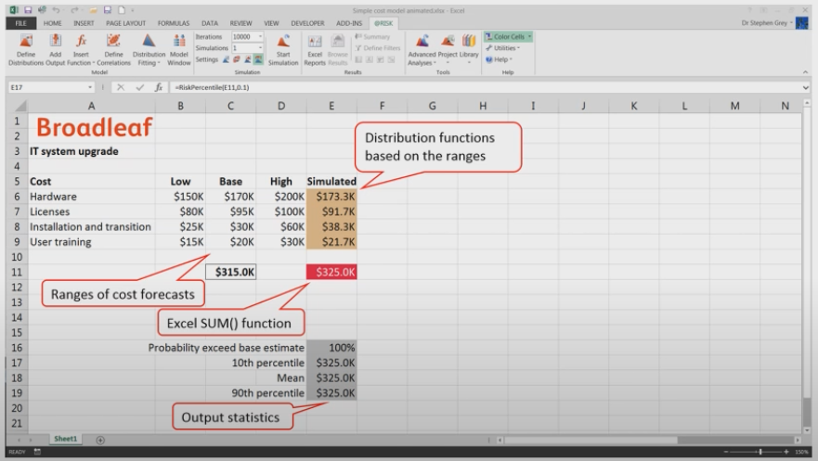
Tool: monte carlo simulation
https://www.youtube.com/watch?v=9LxoP39P5iY (4:53) Monte Carlo simulation of risk in costs of a project. The first 2.5 minutes provide an illustration of variability in a project.
Image from video

Slide 30
Tool: decision trees
Models of real situations and are used to see the potential impacts of decisions by taking into account the associated risks, probabilities, and impacts.
Takes into account future events to make a decision today.
Calculates expected monetary value in more complex situations.
Involves mutually exclusive events.
Example: https://www.youtube.com/watch?v=ydvnVw80I_8

Slide 31
Tool: Decision tree exercise
Handout
A property owner is faced with a choice of:
A large-scale investment to improve her flats. This could produce a substantial pay-off in terms of increased revenue net of costs but will require an investment of $1,400,000. After extensive market research it is considered that there is a 40% chance that a pay-off of $2,500,000 will be obtained, but there is a 60% chance that it will be only $800,000.
A smaller scale project to re-decorate her premises. At $500,000 this is less costly but will produce a lower pay-off. Research data suggests a 30% chance of a gain of $1,000,000 but a 70% chance of it being only $500,000.
Continuing the present operation without change. It will cost nothing, but neither will it produce any pay-off. Clients will be unhappy and it will become harder and harder to rent the flats out when they become free.
Use a decision tree to help make the decision.
Notes:
Based on: http://textbook.stpauls.br/Business_Organization/page_105.htm

Slide 32
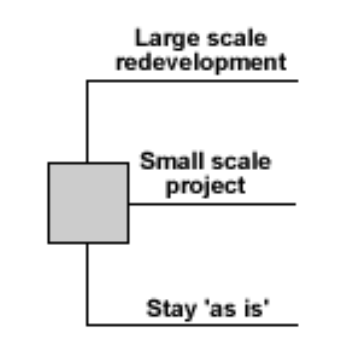
Tool: Decision tree exercise
Handout
Decision nodes - represented by squares (□)
Chance nodes - represented by circles (Ο)
Notes:
Based on: http://textbook.stpauls.br/Business_Organization/page_105.htm

Slide 33
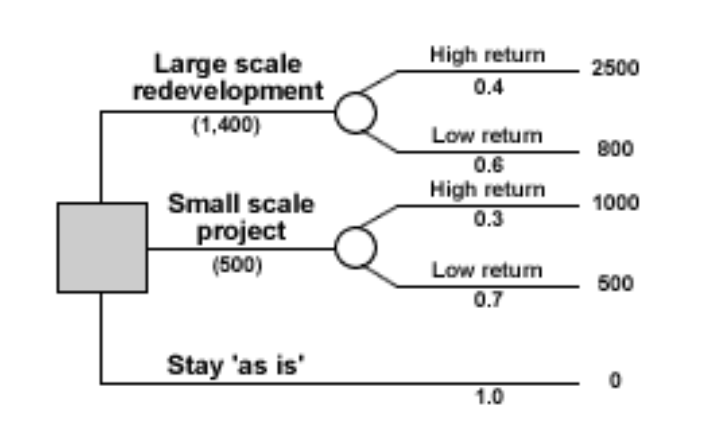
Tool: Decision tree exercise
Sums to 1.0
Sums to 1.0
Decision nodes - represented by squares (□)
Chance nodes - represented by circles (Ο)
Notes:
Based on: http://textbook.stpauls.br/Business_Organization/page_105.htm

Slide 34
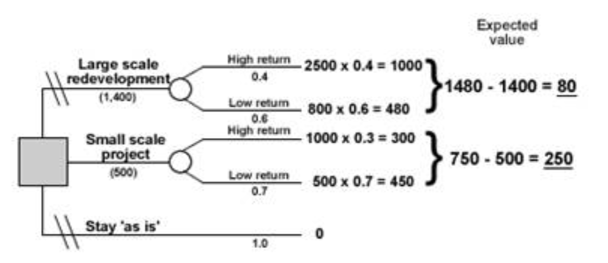
Tool: Decision tree exercise
650
150
350
Decision nodes - represented by squares (□)
Chance nodes - represented by circles (Ο)
Notes:
Based on: http://textbook.stpauls.br/Business_Organization/page_105.htm

Slide 35
Tool: Failure modes and effects analysis (FMEA)
A focused approach that looks at possible “failure modes” – the ways a product or part of the product or process used might fail.
Similar to risk analysis, it also looks at the potential impacts of failure and ways to reduce the probability or mitigate the impacts of such failure.
https://pmstudycircle.com/2016/06/failure-mode-and-effect-analysis-fmea/
Notes:
Scroll down to “Example” heading, note the table and the immediate paragraphs underneath. NOTE: (DET) is described as “how easily you can find the problem”, but a better description indicating the higher the DET number the “worse” things are, would be the likelihood of the customer NOT detecting the problem. Or a more detailed description might be -- how good are the controls in preventing the customer from detecting the failure?

Slide 36
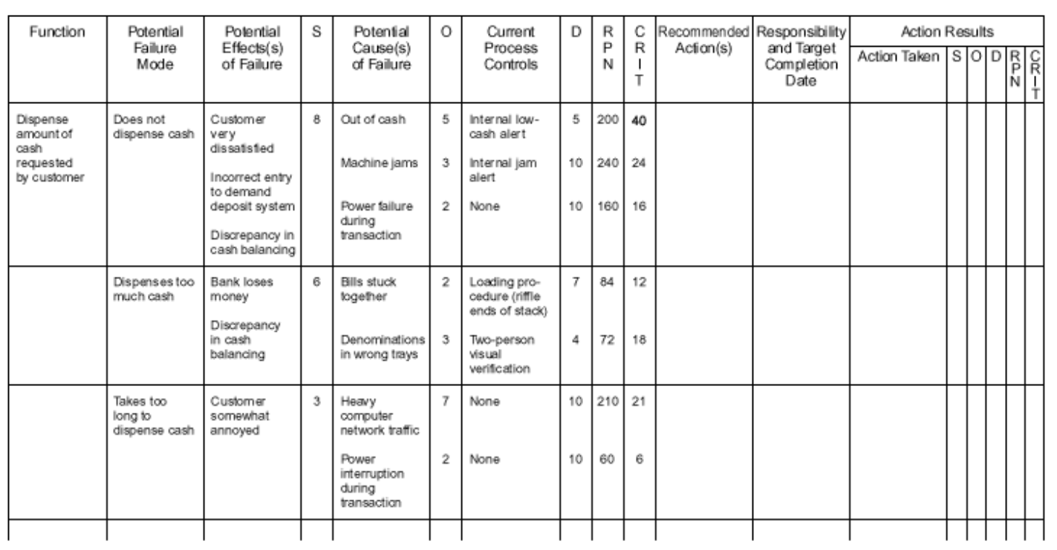
Tool: Failure modes and effects analysis (FMEA)
Function is what we want it to do (dispense cash)
Potential failure modes: how can it go wrong?
SxO=8x5
6x2x7=84
Uncover effects and causes of failure, rate severity (S), occurrence rating (O), detection rating (D) (how well the controls can detect a problem, a 10 is the control is certain NOT to detect it) resulting in Risk Priority Number (RPN) and Critical Factor (CRIT).

Slide 37
Tool: Failure modes and effects analysis (FMEA)
“Machine jams and heavy computer network traffic are highest risks

Slide 38
Steps of perform quantitative risk analysis process
Determine what methods of quantitative risk analysis to use, how and with/by whom.
Determine quantified probability and impact of each risk.
Determine which risks and activities warrant a response.
Determine the level of risk the project currently has.
Determine how much the project will cost and how long the project will take if not further risk management actions are taken to decrease the project risk.
Determine the probability of achieving the cost or schedule objective for the project.

Slide 39
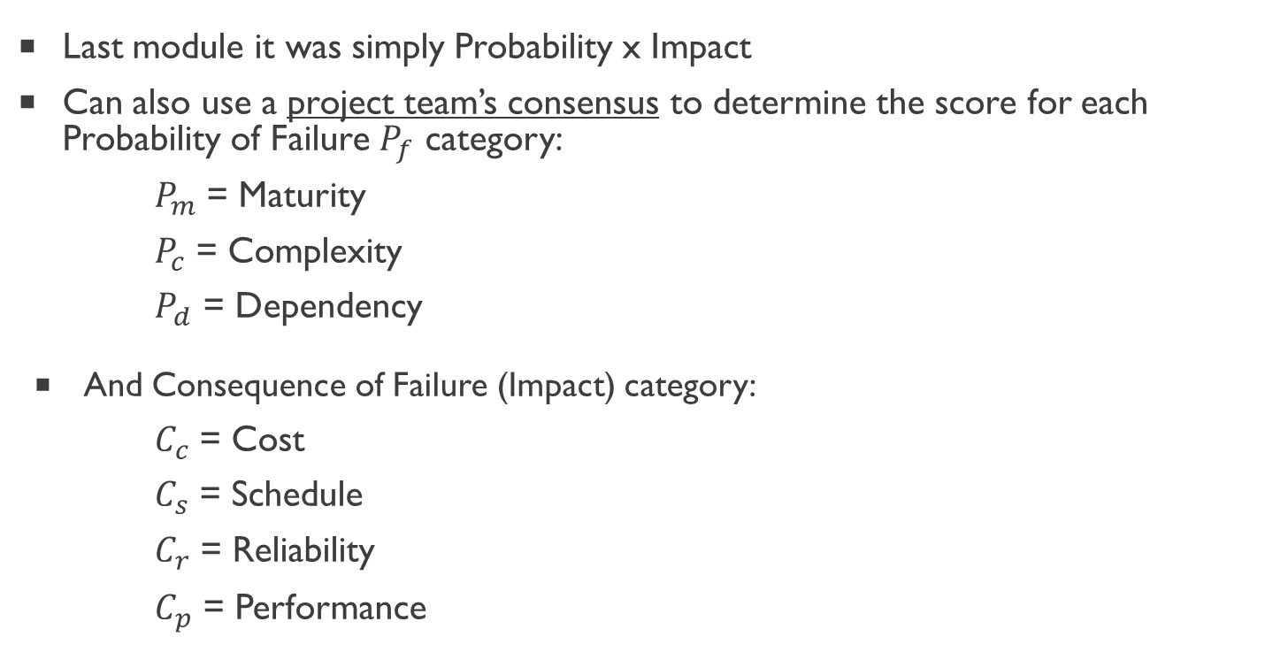
An alternative quantitative method of calculating project risk factor/score
Last module it was simply Probability x Impact
Can also use a project team’s consensus to determine the score for each Probability of Failure $P_{f}$ category:
$P_{m}$ = Maturity
$P_{c}$ = Complexity
$P_{d}$ = Dependency
And Consequence of Failure (Impact) category:
$C_{c}$ = Cost
$C_{s}$ = Schedule
$C_{r}$ = Reliability
$C_{p}$ = Performance

Slide 40
An alternative method of calculating project risk factor/score
This is one example of alternative approaches to measuring risk in projects
Identify factors and assess the probability (P_{f} ) and consequences (C_{f}) of failure
Calculate overall probability and consequence by averaging
Calculate overall risk factor
Rules of Thumb:
Low Risk RF<0.3
Medium Risk RF = 0.3-0.7
High Risk RF >0.70
Copyright © 2013 Pearson Education, Inc. Publishing as Prentice Hall

Slide 41
An alternative quantitative method of calculating project risk factor/score
Assume the following information and calculate the overall risk factor (RF) for this project:
Probability of Failure | Consequences of Failure
Maturity = 0.3 | Cost = 0.1
Complexity = 0.3 | Schedule = 0.7
Dependency = 0.5 | Risk = 0.4
 | Performance = 0.5
Handout
Rules of Thumb:
Low Risk RF<0.3
Medium Risk RF = 0.3-0.7
High Risk RF >0.70

Slide 42
An alternative quantitative method of calculating project risk factor/score
Assume the following information and calculate the overall risk factor (RF) for this project:
Probability of Failure | Consequences of Failure
Maturity = 0.3 | Cost = 0.1
Complexity = 0.3 | Schedule = 0.7
Dependency = 0.5 | Risk = 0.4
 | Performance = 0.5
Handout
Pf = (0.3 + 0.3 + 0.5)/3 = 0.37
Cf = (0.1 + 0.7 + 0.4 + 0.5)/4 = 0.43 (.425 rounded up)
Risk Factor = 0.37 + 0.43 – (0.37 x 0.43) = 0.64
According to the severity levels, this would be classified as medium risk.
Rules of Thumb:
Low Risk RF<0.3
Medium Risk RF = 0.3-0.7
High Risk RF >0.70

Slide 43
Homework and evaluations
Upcoming M6 readings per Course at a Glance summary (i.e., readings from Kerzner, PMBOK, Newton)
Assignments and quizzes, check the Course at a Glance and FOL/Content/Course Assignments & FOL/Evaluations/Quizzes
Reminder: major risk project is coming up
M6 Assignment
(Individual)
Risk Project
(Group)
Build on M6 assignment to complete risk project

Slide 44
References
Mulcahy, Rita, and Rita Mulcahy. Rita Mulcahy's Risk Management Tricks of the Trade for Project Managers: And PMI-RMP Exam Prep Guide: A Course in a Book. [Minnetonka, Minn]: RMC Pub., 2010. Print.
A Guide to the Project Management Body of Knowledge (PMBOK® Guide). N.p.: n.p., n.d. Print.
From Chapter 7 of Project Management: Achieving Competitive Advantage, Third Edition. Jeffrey K. Pinto. Copyright 2013 by Pearson Education, Inc. Published by Prentice Hall, 2013. Print.
Page 92 of Pearson Custom Text: Project Cost Management and Project Time Management

